Slide 1

MINI PROJECT
Disease Prediction Based on
Symptoms
IV/IV B.Tech CSE-III
Project Guide: Sri S. Rajesh
Assistant Professor
Team Members:
K. Sai Kumar(188W1A05E2)
M. Sai Sathya (188W1A05E6)
A. Nadeem(188W1A05B9)

Slide 2
ABSTRACT
The healthcare domain is one of the prominent research fields in the current scenario with the rapid improvement of technology and data. It is difficult to handle the huge amount of data of the patients. It is easier to handle this data through Big Data Analytics. There are a lot of procedures for the treatment of multiple diseases across the world. Machine Learning is an emerging approach that helps in prediction, Diagnosis of a disease. This project depicts the prediction of disease based on symptoms using machine learning. Machine Learning algorithm Random Forest are employed on the dataset and predict the disease. We also store the predicted disease and the symptoms on the database. Its implementation is done through the python programming language. We will predict the disease based on the accuracy of the algorithm. The accuracy of an algorithm is determined by the performance on the given dataset.
Keywords: Big data analytics, Random Forest, Diagnosis of disease, Prediction, Machine Learning Algorithm, Database.

Slide 3
OBJECTIVE
The main objective of this project called “Disease Prediction based on Symptoms” is to predict the accurate disease of the patient using all general symptoms.
This project provides Graphical user interface for the user to Enter the symptoms.
SCOPE
This project is used to predict the disease at the early stage by using the symptoms.
This system will predict the most possible disease based on symptoms..

Slide 4
BASIC CONCEPTS
MACHINE LEARNING:
Machine Learning is the field of study that gives computers the capability to learn without being explicitly programmed. ML is one of the most exciting technologies that one would have ever come across. As it is evident from the name, it gives the computer that makes it more similar to humans: The ability to learn. Machine learning is actively being used today, perhaps in many more places than one would expect.
RANDOM FOREST:
Random Forest is a popular machine learning algorithm that belongs to the supervised learning technique. It can be used for both Classification and Regression problems in ML. It is based on the concept of ensemble learning, which is a process of combining multiple classifiers to solve a complex problem and to improve the performance of the model.

Slide 5
LITERATURE SURVEY
1.Disease prediction by Machine Learning over Big data from HealthCare Communities
Methodology:
Min Chen, Yixue Hao, Kai Hwang describes about the prediction of chronic diseases. The data is collected from central china froman hospital. To over come the difficulty of in complete data, They use a latent factor model to reconstruct the missing data. They propose a new convolutional neural network based multimodal diseases risk prediction(CNN-MDRP) algorithm. The accuracy is 94.8% with a convergence speed.
Advantages:
Deals with both structured and unstructured data
Accuracy is more i.e., 94.8%.
Disadvantages:
Predict only one disease

Slide 6
2.Symptoms Based Disease Prediction using Decision Tree and electronic health Record analysis:
Methodology:
Ranjitha, Radhika, Ramiya Shree proposed a model that predict disease based on the symptoms . They have used the Decision Tree Classifier. It also detect the patient’s health condition. The dataset contains physiological measurements with 40 instances(Diseases) and 132 attributes(Symptoms).
Advantages:
Includes more diseases and symptoms
Uses highly personalised training datasets
Disadvantages:
Difficult to handle the large dataset using this model.

Slide 7
3.Designing Disease Prediction Model Using machine Learning Approach
Methodology:
Dhiraj Dahiwade, Gajanan Patle, Ektaa Meshram proposed general disease prediction model based on the symptoms of the patient. They collect the information of the symptoms from the early patient care. They have used the k-Nearest Neighbour(KNN) and Convolutional neural network(CNN) algorithms for accurate prediction of disease. The accuracy for this model is 84.5%.
Advantages:
Prediction time is less
Gives accurate prediction
Disadvantages:
The complexity of algorithm is more

Slide 8
4.Application of Machine Learning in Disease Prediction
Methodology:
Pahulpreet Singh Kohli, Shriya Arora describes about disease diagnosis and early detection of fatal disease such as Heart disease, Diabetes, Breast Cancer. They have used different algorithms for different diseases prediction. They have used Algorithms like Logistic Regression, Decision Tree, Random forest. They have achieved 98.57% accuracy in Diabetes prediction.
Advantages:
Achieved 98% accuracy in Diabetes prediction.
This model exhibits best accuracy than the existing models
Disadvantages:
Model is Limited to only three diseases.
Uses different algorithms for different diseases prediction.

Slide 9
5.Intelligent Parkinson Disease Prediction Using Machine Learning Algorithms
Methodology:
Kaladhar, Sriram, Venkateswara Rao, Satya Narayana proposed a model for the Parkinson Disease prediction. They have used the voice dataset for the prediction. They have tested various algorithms like SVM, K-NN, Random Forest. Among these algorithms Random Forest shows good accuracy. The dataset contains the voices of 31 people.
Advantages:
Uses voice dataset which gives accurate prediction.
Achieved 90% accuracy through Random Forest Algorithm.
Disadvantages:
Handling the voice dataset is difficult.

Slide 10
6.Study of Machine Learning Algorithms for Special Disese prediction using Principal of Component Analysis
Methodology:
Dhomse Kanchana, Mahale Kishore, describes mainly about the PCA that has done to find the minimum number of attributes required to enhance the precision of various supervised learning algorithms. They have studied about the supervised machine learning algorithms to predict heart disease. They have also discussed about variety of algorithm approaches for diabetic disease prediction.
Advantages:
They have reduced the attributes that require for the heart disease prediction.
They have used WEKA data mining technique to analyse the algorithm accuracy.
Disadvantages:
Time taken to build this model is more

Slide 11
7.Disease Prediction using Machine Learning
Methodology:
Sai Akhil, Suhesh, Sirisha, Bhavana, proposed a model to analyse the patient datasets by using linear regression algorithm. They have collected the data from the people who are suffered from various diseases. The model also predicts the sub diseases.
Advantages:
Included more Symptoms for disease prediction.
The complexity of the algorithm is less
Disadvantage:
Accuracy is less.
Dataset pre-processing is not done properly

Slide 12
8.Application of Big Data Analytics in Healthcare System to Predict COPD
Methodology:
Shaila H Koppad, Anuoamma Kumar, describes about the Data mining application of big data, and also proposed a model for Chronic Obstructive Pulmonary Disease(COPD) prediction using Decision Tree technique. They have considered the centralized clinical data repository contains patient’s details with reference to unique aadhaar number, which helps to know about the treatments taken by the each patient in different hospitals and doctor treated.
Advantages:
They have used the Indian e-health System through “Aadhaar”.
Accuracy for this model is more than 90%
Disadvantages:
Time taken to build this model is more.

Slide 13
Hardware Requirements:
System :Intel Core i3,i5,i7
RAM :512Mb or above
Hard Disk :10GB or above
Software Requirements:
Operating System :Windows 7,10 or Higher Versions
Platform :Jupiter Notebook
Front End :Python Tkinter
Back End :Python and Files

Slide 14
DATASET
This proposed system includes data collection and understanding the data to study the patterns and trends which helps in prediction and evaluating the results.
We are taking two datasets Training dataset and testing dataset
The dataset contains the 133 attributes In which 132 attributes represents the symptoms and the other one is the disease(output).
The user enters the five symptoms to predict the disease.
The datasets is in the form of .csv(comma separated values) files.

Slide 15
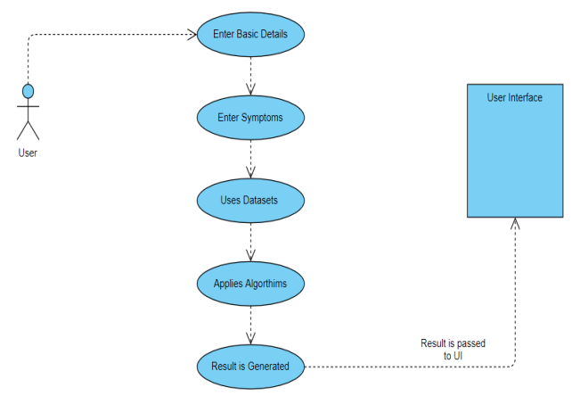
Use case

Slide 16
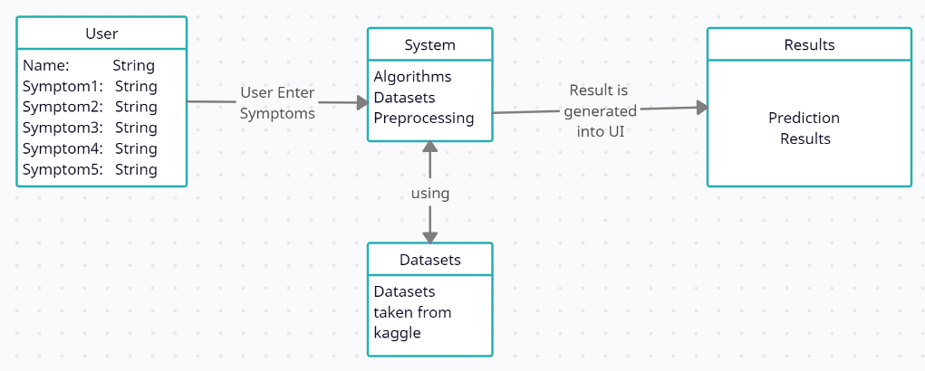
Class Diagram

Slide 17
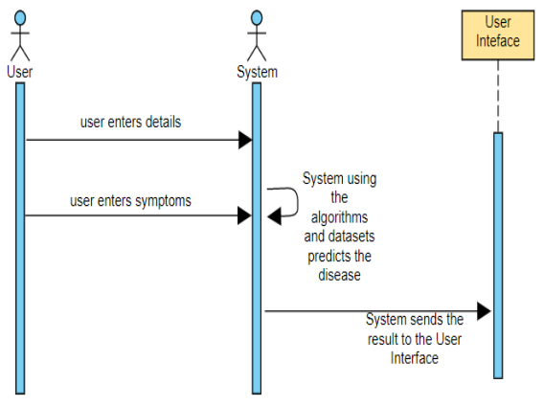
Sequence Diagram

Slide 18
METHODOLOGY
The project Disease Prediction based on symptoms is developed to overcome general disease in earlier stages as we all know in competitive environment of economic development the mankind has involved so much that he/she is not concerned about health according to research there are 40% peoples how ignores about general disease which leads to harmful disease later. The Project "Disease Prediction based on symptoms" is implemented using python completely. Even the interface of this project is done using python's library interface called Tkinter. Here first the user needs to enter the name and select the symptoms from the given drop-down menu, The user must enter the name and atleast two symptoms to predict the disease, for more accurate result the user needs to enter all the given symptoms, then the system will provide the accurate result. If the user doesnot enter the name or atleast two symptoms the system shows an prompt window showing the corresponding message. This prediction is basically done with the help of Random Forest algorithm. When the user enters all the symptoms then he/she needs to press the prediction button. The Reset Inputs is used to reset all the inputs given by the user. Exit System button is used to close the system.

Slide 19
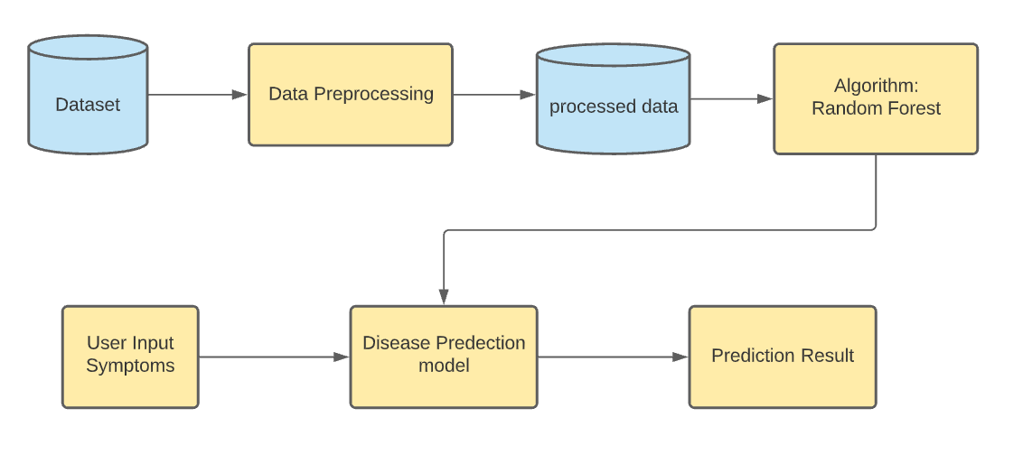
Architecture

Slide 20
MODULES
MODULE 1
Dataset Collection
MODULE 2
Model Creation(Random Forest Algorithm)
MODULE 3
User Interface and Database Creation

Slide 21
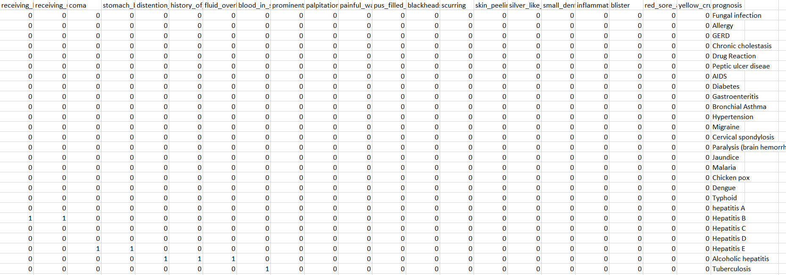
Dataset Collection
The dataset contains 133 attributes. In which 132 are symptoms and the remaining one attribute is diseases. The dataset is in the binary format. Covert the diseases into the numeric form by replacing each disease with the number.

Slide 22
Model Creation (Random Forest Algorithm)
An ensemble learning method for classification, regression and other tasks that operates by constructing a multitude of decision trees at training time.
Working of Random Forest Algorithm
Step1 - First, start with the selection of random samples from a given dataset.
Step2 - Next, this algorithm will construct a decision tree for every sample. Then it will get the prediction result from every decision tree.
Step3 – In this step, voting will be performed for every predicted result.
Step4 – At last, select the most voted prediction result as the final prediction result.

Slide 23
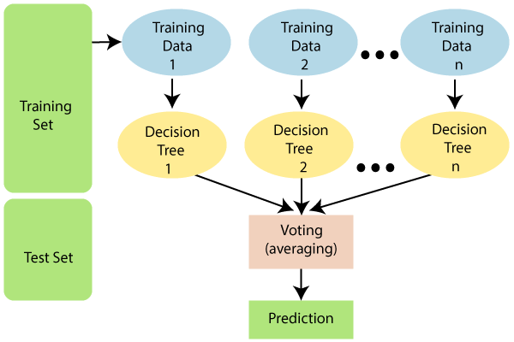

Slide 24
User Interface and Database Creation
Graphical User Interface (GUI) is nothing but a desktop app that provides you with an interface that helps you to interact with the computers and enriches your experience of giving a command (command-line input) to your code. They are used to perform different tasks in desktops, laptops, and other electronic devices, etc. It is mainly used as an interface between the user and the system.
The framework that is used for GUI creation is Tkinter. It is famous for it’s simplicity and graphical user interface. It is open-source and available under the Python License. It comes with pre-installed Python3.
The predicted values will be stored in the database. We can create, access or drop the table in the database by importing the sqlite3 module in the python code. The database contains one table which contains seven columns.

Slide 25
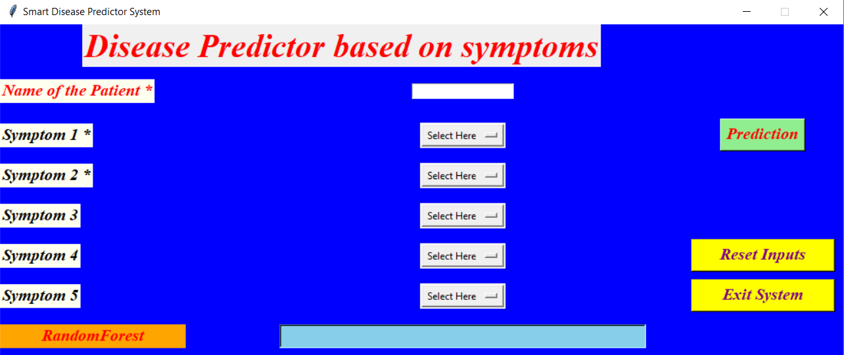
Output/Result
GUI Screen

Slide 26
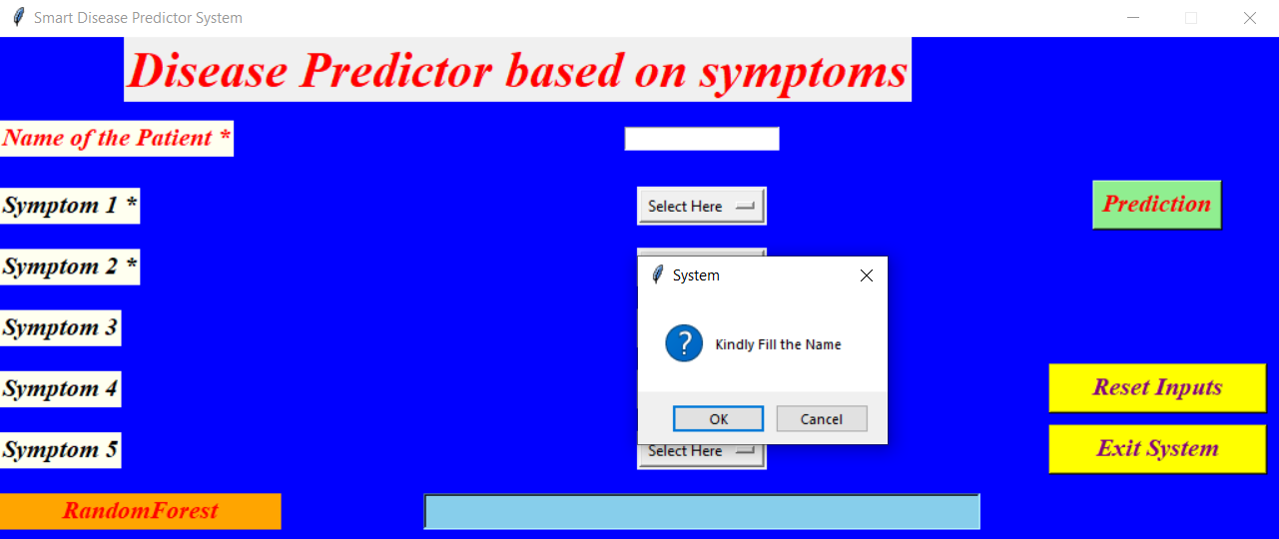
Error Detection

Slide 27
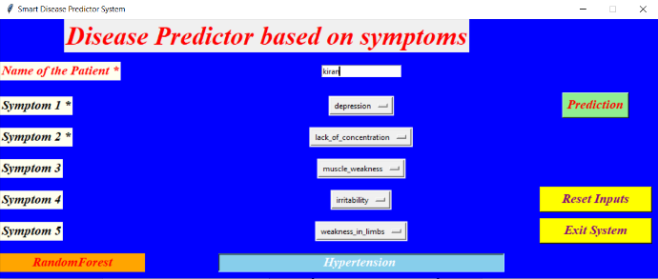
Predicted disease for the input symptoms

Slide 28
REFERENCES
[1] Min Chen, Yixue Hao, Kai Hwang, Fellow, IEEE, Lu Wang, and Lin Wang (2016) Disease Prediction by Machine Learning over Big Data from Healthcare Communities. [2] S Radhika, S Ramiya Shree, V Rukhmani Divyadharsini, A Ranjitha(2020) Symptoms Based Disease Prediction Using Decision Tree and Electronic Health Record Analysis.
[3] Dhiraj Dahiwade, Prof. Gajanan Patle, Prof. Ektaa Meshram (2019) Designing Disease Prediction Model Using Machine Learning Approach.
[4] Pahulpreet Singh Kohli, Shriya Arora (2018) Application of Machine Learning in Disease Prediction.
[5] Tarigoppula V.S Sriram, M. Venkateswara Rao, G V Satya Narayana, DSVGK Kaladhar, T Pandu Ranga Vital (2013) Intelligent Parkinson Disease Prediction Using Machine Learning Algorithms.
[6] DhomseKanchan B, MahaleKishor M (2016) Study of machine learning algorithms for special disease prediction using principal component analysis.
[7] S.Sai Kumar, B.V.Subba Rao, J.Sirisha, B. Anusha, A. Sai Akhil, K.Venkata Suhesh, K.Bhavana (2020) Disease Prediction Using Machine Learning.
[8] Koppad SH, Kumar A, (2016)Application of big data analytics in healthcare system to predict COPD.

Slide 29


